Slide 1
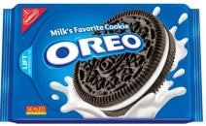
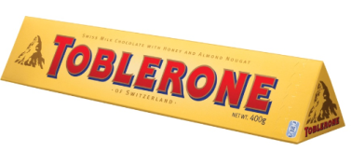
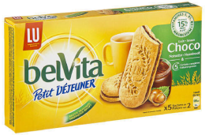
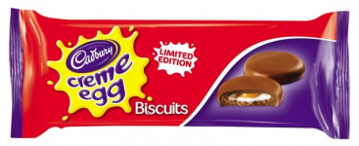
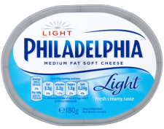
Presentation – translate plus
A global partner for translation and interpreting services

Slide 2
Overview
About translate plus
General facts and figures
Services
Capabilities
Quality assurance
Global account team
How to contact us
i plus
review plus
How to obtain a quote for translation
How to order translations
How to order interpreting services
i plus and review plus User Guides
Translation and interpreting prices

Slide 3
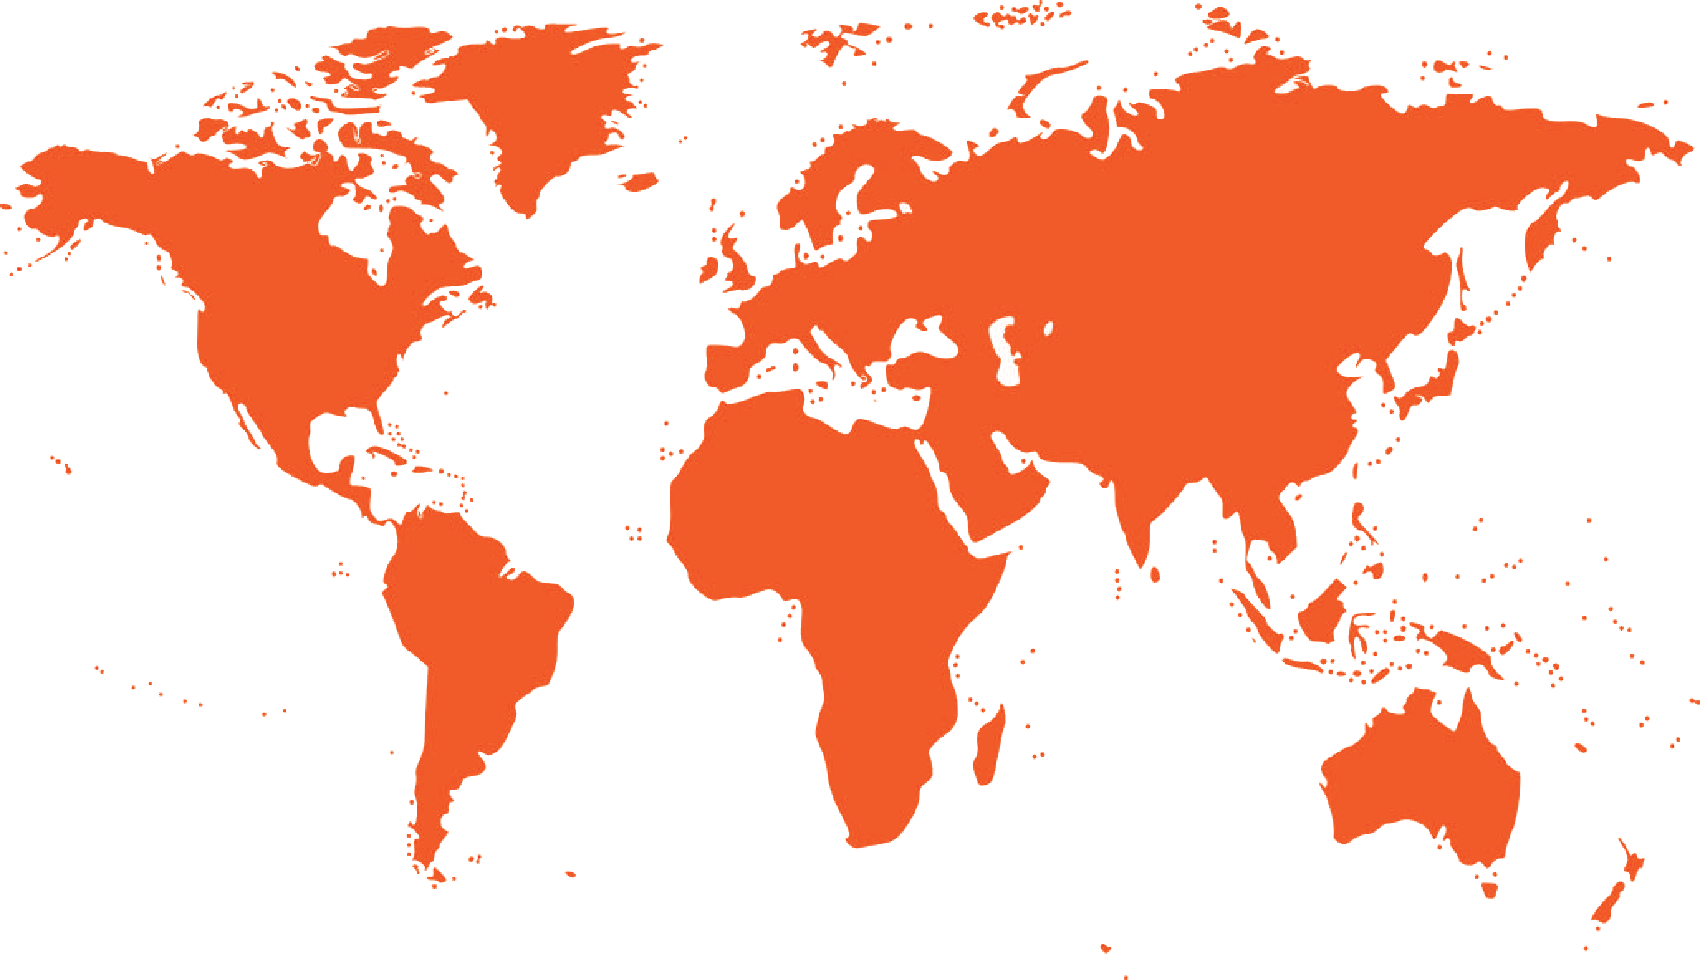
About translate plus
As a Global Top 40 translation services provider, we offer a full range of services in over 200 languages. translate plus has been chosen through a tender process to service Mondelēz International with translation and interpreting services on a global level.
Notes:
translate plus is an innovative and fast-growing language services provider, consistently expanding worldwide. We are able to do so because we deliver the best quality at the best price every time and are passionate about our company and clients. translate plus is unique in many ways and one of them is that we tailor our solutions to suit every single client.

Slide 4
General facts and figures
Over 120 permanent staff
11 offices worldwide & 30 partners
11,000 linguists around the world
One-stop shop
ISO 9001, ISO 14001, ISO 17100
GALA, tekom, NTIF
Technology leadership
Award Winning
Notes:
At translate plus, we have over 100 permanent staff that are all very competent in what they do and all members of staff are fluent in at least 2 languages, often even more. We have 10 offices around the globe, over 30 partners across different countries and around 11,000 translators, proofreaders and interpreters all over the world, which means we can offer you our services 24/7.
As a company, we are certified to ISO 9001:2008 and EN 15038. This means that our quality processes are documented and strictly followed for every assignment, ensuring that you will receive the same excellent level of service every time you use us. translate plus have also pre-registered to be certified against ISO 17100, a new international translation standard which will replace the European standard EN 15038.
From a technological viewpoint, translate plus are within the top five language services companies globally due to the bespoke tools and technical solutions we can offer, which has led to us winning several awards.

Slide 5
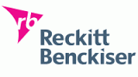
translate plus are specialists
translate plus have a lot of experience translating for FMCG companies such as Reckitt Benckiser, Barry Callebaut and Nestlé. Below are some more references (although the list is not exhaustive). If you would like to know more about what we do for other clients, please feel free to request further information via Mondelez@translateplus.com.

Slide 6
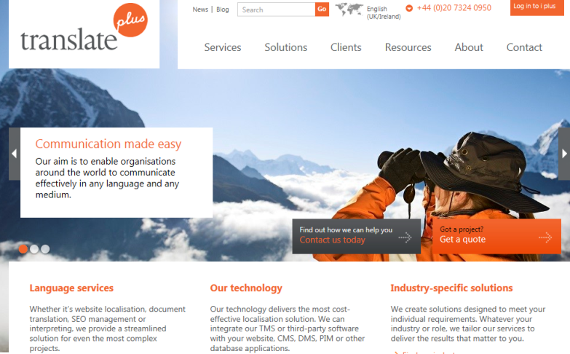
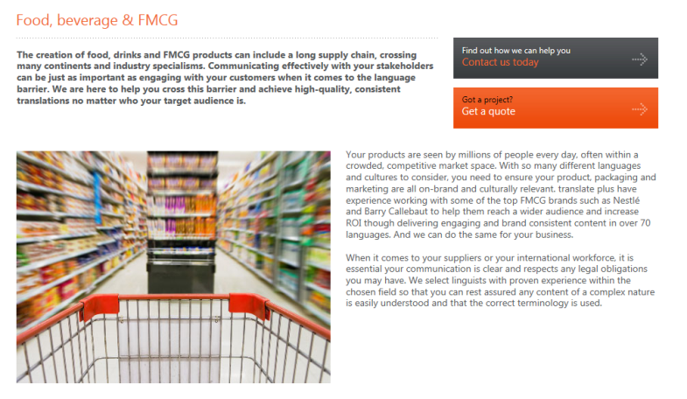
Our website
Please see our website www.translateplus.com. Here you will find a lot of information about us, our services and technology.
For more information about the services we provide to F&B and FMCG companies, please click here or on the images on the right.
Our global headquarters:
5 Waterside 44-48 Wharf Road London N1 7UX uk@translateplus.com +44 (0)20 7324 0950

Slide 7
Services
Document & text services
Interpreting services
Creative copy & transcreation
Web, mobile & software services
Multimedia & audio-visual services
Testing, QA & consultancy
+
Notes:
We offer a full range of services in over 200 languages such as translation, interpreting, creative copy and transcreation, website localisation, multimedia and language consultancy. All these services offer something unique – something with a “plus”. We have over 17 years’ of experience providing a comprehensive range of language services that cover more than 500 language combinations, including:
· translation of:
o marketing material for web and print, press releases, newsletters and presentations
o e-learning content
o legal documents including sworn, notarised and legalised translations
o financial documents such as annual and quarterly reports
o technical documentation
· software and website localisation:
o including CMS integration via web service or FTP
o in Word, Excel, CSV, XML, HTML
· multilingual Desktop Publishing (DTP):
o European languages, Asian languages and right-to-left languages
o programs include (but are not limited to): InDesign 4, CS5, CS 5.5, CS6, Photoshop, Illustrator CS FrameMaker 8, 9, 10, QuarkXPress 8+9, Quicksilver and Microsoft PowerPoint
· interpreting (consecutive and simultaneous):
o consecutive and simultaneous interpretation for business meetings, conferences, tradeshows and other meetings
o over-the-phone interpreting (OPI) for conference calls, webinars, trade events, site visits and other meetings
· SEO (search engine optimization) translation
· multilingual copywriting:
creative copy and transcreation for advertising campaigns, taglines, logos and other sensitive marketing collateral
· linguistic validation and back-translations
· language consultancy:
o for taglines, product names, corporate logos and brand imagery
· multimedia services:
o script preparation, translation and formatting
o lip synchronization
o documentary
o voiceover narration
o sound design, editing, mixing and sweetening
o CD & DVD authoring
o video duplication and editing
o format conversions (e.g. MP3, MP4, MPG, AVI, WAV, etc.)
More information about translate plus is available on our website: www.translateplus.com

Slide 8
Capabilities
Translate into over 200 languages
Fast turnaround times
Improved workflow efficiencies
Cost and time savings
Tailored workflows for Mondelēz

Slide 9
Quality assurance
Native speakers
5 years’ experience
Industry specialists
Master’s degree
translate plus certified
Visibility
Independently audited
Notes:
The linguists we use are industry experts, have a minimum of five years’ active experience and only translate into their native language. We also work in any file format and offer competitive pricing without compromising on quality.
Most of our linguists have a Master’s degree or an equivalent diploma or university degree in Translation, Interpreting or Languages, often in both the source language and the target language.
translate plus certified: our translators need to go through a certification process before they can start working as linguists for translate plus.
Visibility: through i plus you can see which translator has been used and translate plus will always use preferred translators that have worked on Mondelēz projects before.
Certifications: we are an ISO 9001:2008 and EN 15038 certified company. This means that our quality processes are documented and stringently followed for every assignment. These two certifications govern all of our processes in relation to quality control and language service management. Our Quality Management Guidebook is regularly reviewed and updated where appropriate.
ISO 9001 is a globally recognised quality management standard, ensuring all processes are documented and training is provided at all levels. While this standard offers a high-quality benchmark to start with, it is not geared specifically to the language services industry and while we are aware of the quality assurances we have in place, we understand that our clients need to be sure of exactly what we are doing. The European Standard EN 15038 guarantees exactly this; it is a globally approved standard for translation service requirements and the only standard recognised by the European Union. The standard establishes a series of requirements regarding the production process and the quality of the translation service and the relationship between the translation service provider and the client. It focuses on core translation processes including commissioning, translation, proofreading, review, project management, quality control, traceability, assignment, use of technical resources, pre-translating process, source text analysis, terminology work and the style guide, glossaries and other such language assets. It is globally known as the most accepted way of certifying the translation services of a translation company.
While many organisations in the language services sector self-certify their adherence to BS EN 15038, we have been independently certified through QMS International Plc. so that our customers can rest assured that high-quality management processes are maintained and any feedback they choose to share with us will be tracked and recorded accordingly.
translate plus have also pre-registered to be certified against ISO 17100 (http://www.iso17100.com/), a new international translation standard which will replace the European standard EN 15038 and is said to become the industry benchmark on a global scale.
translate plus are also certified to ISO 14001:2004, which is an environmental management standard. This standard ensures that, as an organisation, we apply a responsible approach to how our services are offered and actively consider and mitigate against possible negative impact of our operations on the environment. In line with our environmental policy and statement, we have clear aims in in terms of lowering our carbon footprint and are aiming to become a “paperless” organisation, by reducing our paper usage by 20% yearly.

Slide 10
Quality control process
Linguists
Preferred translators
Mondelēz experts
translate plus certified
Technology
qa plus
Translation memories
Multiterm
Information managment
Project checklist
E-learning
Style guides
Glossaries
Notes:
At translate plus, we believe that there are 3 elements that enhance our quality control process:
Linguists
Using native-speaker translators that hold a degree in translation, have sufficient translation experience and a specialisation in a particular field. We also encourage linguists to focus on no more than 2 subject matter areas and/or two source languages when translating into their own mother tongue.
We will use the same linguists all the time which means they will become Mondelēz experts.
Our linguistic certification and monitoring programme seeks to eliminate under-performing linguists. This is when underperformance continues despite warnings and additional training, as we require all of our linguists to work towards the same high standards.
Technology
The use of glossaries is enforced by applying translation memory technology to every editable translation assignment and using smart QA technology. Examples of such QA technology would be Multiterm and XBench. Multiterm is a terminology management software that seamlessly integrates with translation memory tools such as Trados and would instantly flag up a core term to the linguists involved in the translation project. XBench is a quality management software which checks source and target content for possible terminology and numerical mismatches or missing sentences.
Information Management
In addition to including an independent proofreading and editing step, we support our linguists with multilingual glossaries provided by clients and our terminologists.
On a stylistic and project management level, we strive to compile company, department or brand-specific style and design guides for our clients to capture specific conventions with regards to tone of voice, numerical values (e.g. date and currency formats or weight) and layout requirements. Project checklists for linguists and internal personnel at translate plus (e.g. Quality Mangers, Project Managers or DTP specialists) ensure that those agreements are followed and in the right order.

Slide 11
Global account team
European Sales Director
Svenja Müller
Operations Director
Liina Puust
Account Director
Max Bayley
Max.Bayley@translateplus.com
DDI: +44 (0)20 7324 0995
Dedicated Project Management Team
Interpreters
Quality Assurance
Manager & QA team
Terminology
Specialist
Translators
Training Manager
Serena Imperati
Technical
Support Team
Linguistic Resources
Manager
Primary Point
of contact for Mondelēz
Support Roles
Notes:
This is the global account team for Mondelēz. During the start up phase, the Project Management Team and Account Manager will be the primary points of contact.
The Project Management Team will be supported by local Partners and dedicated Mondelēz Project Managers, terminology specialists, interpreters and translators who are all industry experts and very experienced. We at translate plus know how important it is that every project is completed with a high standard of quality and service.
To ensure that all employees as well as external linguists have access to the relevant information and receive the training they require, we have a dedicated Training Manager for the team, Serena.
The technical support teams include our IT department, developers, DTP specialists and localisation engineers, who are all in-house.
Our Linguistic Resources team is in charge of sourcing and certifying suitable linguists as well as carrying out independent internal quality audits in conjunction with our QA team.

Slide 12
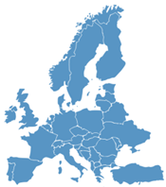
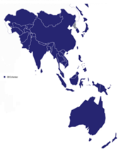
How to contact us
General e-mail address: Mondelez@translateplus.com
Mondelēz EU: MondelezEU@translateplus.com
Mondelēz APAC: MondelezAPAC@translateplus.com
Mondelēz LA: MondelezLA@translateplus.com
Mondelēz NA: MondelezNA@translateplus.com
Mondelēz EEMEA: MondelezEEMEA@translateplus.com

Slide 13
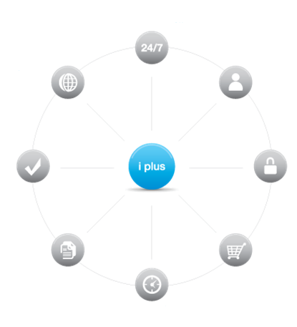
i plus
24/7 access via any standard web browser
Integrate with websites, CMS, DMS and database applications
Password protected access supporting customised user permission
review plus: approve translations before they go live
Secure access with internet banking-level encryption
i plus
Online access to translation memories and glossaries
Order any language service instantly
Real-time project status information
Notes:
i plus is our online translation and language management platform that we will make part of our service offering to Mondelēz. Within this platform you have access to a number of applications, each designed to streamline your translation process, leading to a reduction in time and cost on every job submitted via this method. translate plus offer a number of tailored solutions such as match plus, review plus and many others. We closely follow industry trends and current solutions and as far as we know, a number of our solutions, for example i plus, our Translation Management System and all of its functionality, are something no other language services company is able to offer to clients in its entirety.
Its primary features are:
allows secure messaging and document sharing (virtual data room) utilising 128-bit SSL encryption – the same as that used for internet banking
incorporates password-protected user access with customised permission levels
allows 24/7 access via any standard web browser
available in any language(s) needed
allows access to real-time project status information
project archive
allows 24-hour access to translation memories and glossaries
integrated reporting tools show spend and word count statistics over a specific time period
can integrate with websites, CMS, DMS, e-procurement systems and database applications
the review plus component allows clients to approve translations before they go live in a simple dual-language table, regardless of the original format

Slide 14
i plus: the benefits
Save time
Overview of entire organisation translation usage
Send jobs and receive quotes fast and easy online
Gain complete transparency
Instant reporting on spend
Overview of invoices
Reduce costs
Memory savings
Decrease management overhead
Reviewers time
Reduce time by 18%
Get an easy and tailored solution
Save money: up to 50%
Notes:
In addition to translation memory technology, the use of project management technology such as our online translation management platform, i plus, in conjunction with its powerful content review module, review plus, further decreases project management time on our clients' side by at least 18% (customer survey carried out in 2014). Thanks to our suite of internally developed tools, which includes a file processing tool called processor plus, we are in a position to absorb project management costs irrespective of the number of target languages involved in a project.
Why is i plus good for you?
Save time with a centralised platform, allowing you to see at a glance all of your organisation’s translation usage
Benefit from consistency across your brand, thanks to the automatic updating of translation memories
Reduce costs due to memory savings and decreased management overhead and reviewer time
Gain complete transparency, with instant reporting on spend, review statistics, deadlines and more
Customise i plus to meet your exact requirements – if there is something extra you need, we can build it for you!

Slide 15
review plus
review plus is a cloud-based review tool and part of i plus that allows you to review all file formats online.
It imports changes made online to your translation memory, which saves time and costs as you will not have to make the same changes again.
It enables coordinators to monitor the status of review tasks and sends automatic notifications for overdue tasks.
You can see statistics of changes including information on how much and what was changed.
The system features a task time tracker: when was the file sent, accepted and completed.
Admin users can assign review tasks.

Slide 16
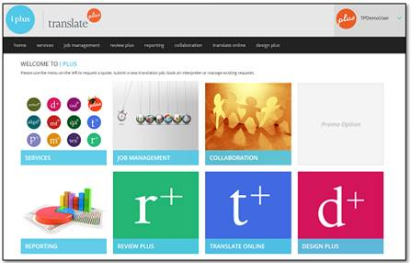
i plus: interface

Slide 17
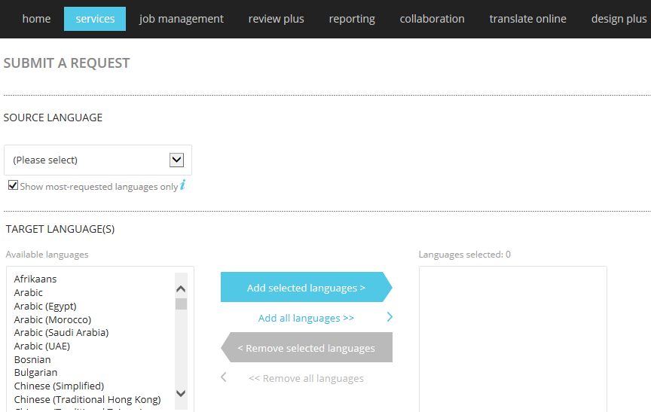
i plus: submit a request for translation

Slide 18
How to obtain a quote for translation
Use your login details to log into i plus via https://iplus.translateplus.com/.
Or send an e-mail to: Mondelez@translateplus.com. (either for direct contact with translate plus, or for asking first-time access to i plus tool)
When you are in the system, please go to “services”.
If you need a quote before the job starts, please chose: “obtain a translation quote”.
Fill in the information that is required such as source and target languages, PO number (if available), if DTP is required and the deadline for the project.
Please upload the file/s (preferably in an editable file format) and also reference material if you have any.
Following submission of your enquiry, you will receive a confirmation e-mail from translate plus with a quote number.
Once we have analysed the source file and prepared the quote for you, you will receive an e-mail and can approve the quote on i plus.

Slide 19
How to order translation
Use your login details to log into i plus via https://iplus.translateplus.com/.
Or send an e-mail to: Mondelez@translateplus.com. (either for direct contact with translate plus, or for asking first-time access to i plus tool)
When you are in the system, please go to “services”.
When you want to submit a request for translation, please press “submit a translation request”.
Fill in the information that is required such as source and target languages, PO number, if DTP is required and the deadline for the project.
Please upload the file/s (preferably in an editable file format) and also reference material if you have any.
Following submission of your project, you will receive a confirmation e-mail from translate plus with an order number.

Slide 20
What to think of when ordering translation services in i plus
Upload the original file in an editable file format if possible (e.g. MS Office, InDesign, XML etc.).
Include any reference material that is relevant for your project and that you would like us to share with our linguists.
If DTP/layout work is needed, please indicate this in the order, including links and fonts.
Please choose the reviewer in i plus when ordering the translation. Alternatively, you can write the e-mail address and language combination in the notes section. Please indicate the deadline for the project and also the deadline by when the Mondelēz in-house reviewers are to complete their tasks. Via the review plus section, the reviewer can edit the file online and your translation memory will update automatically.
Please include any additional information in the notes section.

Slide 21
How to obtain a quote for interpreting services
Use your login details to log into i plus via https://iplus.translateplus.com/.
Or send an e-mail to: Mondelez@translateplus.com. (either for direct contact with translate plus, or for asking first-time access to i plus tool)
When you are in the system, please go to “services”.
To receive a quote, please choose: “obtain an interpreting quote”.
Fill in the information that is required such as source and target languages, PO number (if available), event location and day/time of the assignment.
Please upload reference material if you have any.
Following submission of your enquiry, you will receive a confirmation e-mail from translate plus with a quote number.
When the quote is ready you will receive an e-mail and can approve the quote on i plus and then the project will begin.

Slide 22
How to order interpreting services
Use your login details to log into i plus via https://iplus.translateplus.com/.
Or send an e-mail to: Mondelez@translateplus.com (either for direct contact with translate plus, or for asking first-time access to i plus tool)
When you are in the system please go to “services”.
If you would like to book an interpretation job, select “book an interpreter”.
Fill in the information that is required such as source and target language, date, time and duration of assignment, location of assignment and PO number.
Please include any relevant information in the notes or additional information section.
Once we have prepared the quote for you, you will receive an e-mail and can approve the quote on i plus.

Slide 23
What to think of when ordering interpreting services in i plus
Please include information about the subject so we can make sure that the interpreter is comfortable with the subject matter.
Send reference material well before the event. This is a good tip to help ensure that the linguists are comfortable with the subject matter and to be able to raise any queries in advance.
Please include information in the notes section if any equipment is needed.
For longer projects please provide a clear schedule of each day, so the interpreters know when and where they should be at all times.
Any additional information? Please include them in the notes section of i plus.

Slide 24
i plus and review plus User Guides
Please find the i plus and review plus user guides by clicking on the icons below.
You can also find some useful YouTube videos about review plus via the link below.
https://www.youtube.com/user/translateplusltd/videos

Slide 25
Translation workflow
Enquiry received
Assessment of requirements
Quote provided
Translation begins
Proofreading by
2nd linguist
Manual quality checks &
qa plus
qa plus
& spell-check
Internal review
Final QA check
Glossaries and memories updated
Go live!
Translation queries
Notes:
A representative project workflow is as follows:
1. translate plus receive an enquiry or a job from any of Mondelēz markets via i plus. In i plus you can choose to proceed with the job directly or to obtain a quote first. At the project setup stage, the translate plus Project Director for Mondelēz will discuss all necessary aspects of the project with the requesting party and will be responsible for arranging schedules with all project stakeholders. All information is entered into our internal job management system, which helps to prevent delays or unexpected “bottlenecks” through its built-in enterprise resource planning tools. The Project Director will be supported by the Account Manager who will assist Mondelēz with review meetings, commercial and other enquiries.
2. Any pre-processing or extraction processes (e.g. for XML and XBRL files, or DTP formats) are undertaken in conjunction with our technical teams and the translation package is put together by the Project Director, comprising of source files, reference material, glossary and style guide, translation memory and project brief. For complex file formats such as XML or XBRL, we would use our powerful file handling software tool, processor plus, to ensure only text which is to be translated is accessible by our linguist and any structural information such as tags are left untouched. processor plus is fully customisable and can be coded according to the specific tag structure of each individual file.
3. The translator begins work with the project brief as the starting-point. All linguistic or other queries are channelled via the Project Director and his Project Managers.
Following translation, the translated files will be checked by one of Mondelēz’s dedicated Project Managers using our file verification tools, including our proprietary quality assurance software, qa plus. This tool is used to prevent and detect potential errors between source and target content. For example, where a number exists in the source text but is different in the target text, or a comma is misplaced in numerical detail (both of which could have severe consequences, for example when dealing with financial statements or fund prospectuses), these would be highlighted to the Project Manager for verification. qa plus can also report on other areas such as character-length limits, double spaces and more.
An internal Quality Assurance verifier is then responsible for checking through all target language files for the job. He or she will focus on specific “cross-language” aspects such as numbers, units, formatting, adherence to style guides and glossaries and any aspects particular to the project which may have been identified at the preparatory stage. The QA verifier is responsible for discussing any findings with the translator(s), while keeping the Project Director informed.
Translations are then checked by a second linguist, to ensure another pair of eyes assesses the text for quality purposes, with particular attention being paid to the style, tone of voice, accuracy and terminology. A thorough spell check is also carried out utilising the most up-to-date dictionaries. Any changes made at this stage are updated to the translation memory and feedback passed on to the original translator, in line with our continuous-improvement methodology.
Following this stage, the Project Director runs qa plus a second time, as well as performing a structural check using our processor plus file processing software, followed by a final visual check. The QA verifier is responsible for discussing any findings with the translator(s), while keeping the Project Director aware.

Slide 26
Interpreting workflow
Enquiry received
Assessment of requirements
Quote provided (for PO generation)
Preparation of interpreting assignment
Interpreters are briefed by translate plus
Reference material is being shared
Set up of technical equipment
On-site briefing interpreters
Interpreting assignment
Disassembly of technical equipment
Debrief interpreters and client
Interpreters travel to the event location

Slide 27
Translation and interpreting prices
Please see the enclosed Excel files for detailed information on translation and interpreting pricing.
Please see the enclosed Excel file for detailed information on the exchanges rates per country (steady for the period Jul- Dec 2015).

Slide 28
Stay Tuned for more..
Dedicated demo webinars for Mondelez stakeholders
Roadshows in key countries, for direct contact with Translate Plus team
Quick guides and advertising material to be shared with all countries, for direct printing
SEPTEMBER

Slide 29
translate plus are looking forward to start working with you! If you have any questions please contact us: Mondelez@translateplus.com

